Slide 1
Parking eaze
Bipolar stepper motor driven by Drv8825 Driver
Raspberry pi Broadcom
PRESENTED BY : Navkiran KAUR

Slide 2
Proposal
My Hardware project aims to move the barrier in the parking slot for the entrance and exit of the vehicle
Using the Nema 17 bipolar stepper motor that will be driven by the driver DRV8825 on the raspberry pi Broadcom platform
The movement of the motor will enhance the direction of the barrier as the motor will rotate in forward and reverse direction.

Slide 3
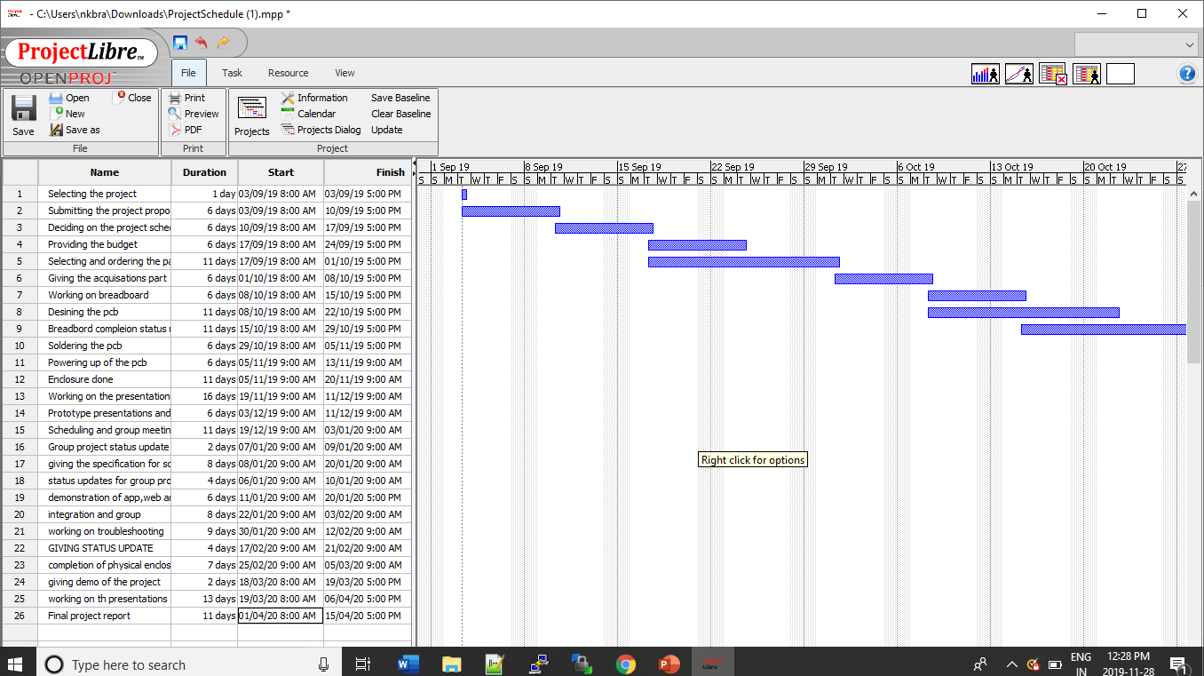
Schedule
Got the delay in my breadboard due to not setting voltage current for driver.
The pcb was incorrectly designed that leads to the delay
the enclosure as my case was big which takes time due to taking measurements accurately.

Slide 4
Budget Total Cost :$173.25
Raspberry pi : $79.99
Nema 17 bipolar stepper motor : $12.99
DRV8825 DRIVER : $14.88
HDMI TO VGA Cable adaptor : $14.99
Power supply adaptor: $19.98
Mouse and Keyboard combo: $25.47
Safety glasses $4.95
Parts kit equipments : already had and headers acquired from the prototype lab

Slide 5
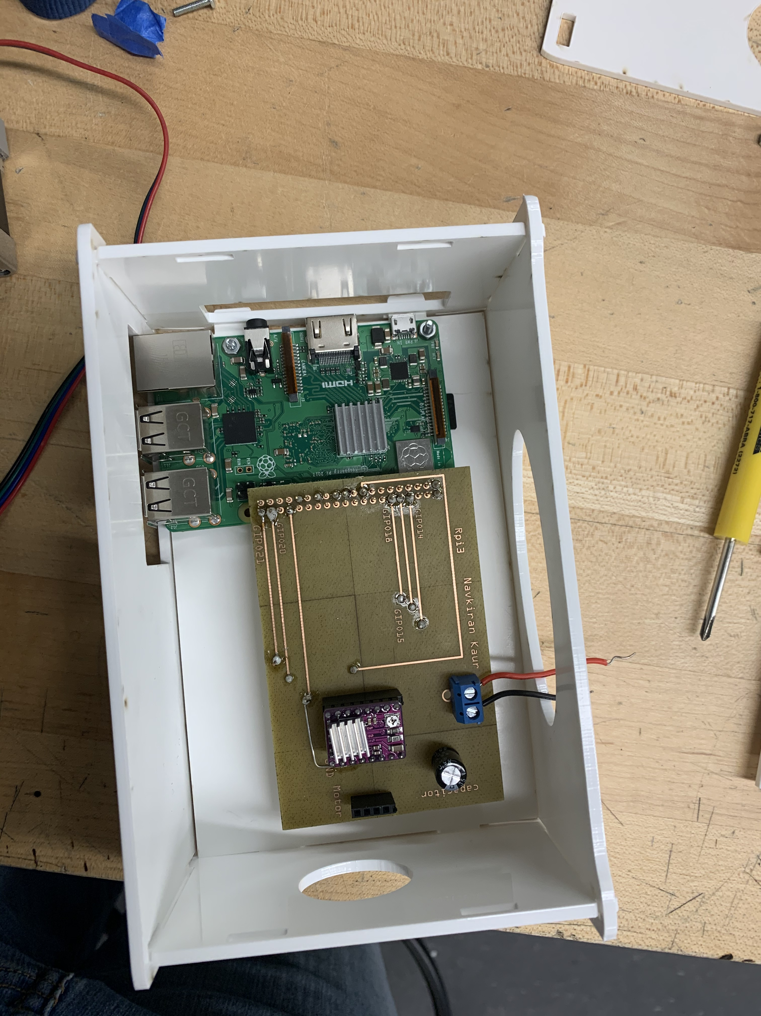
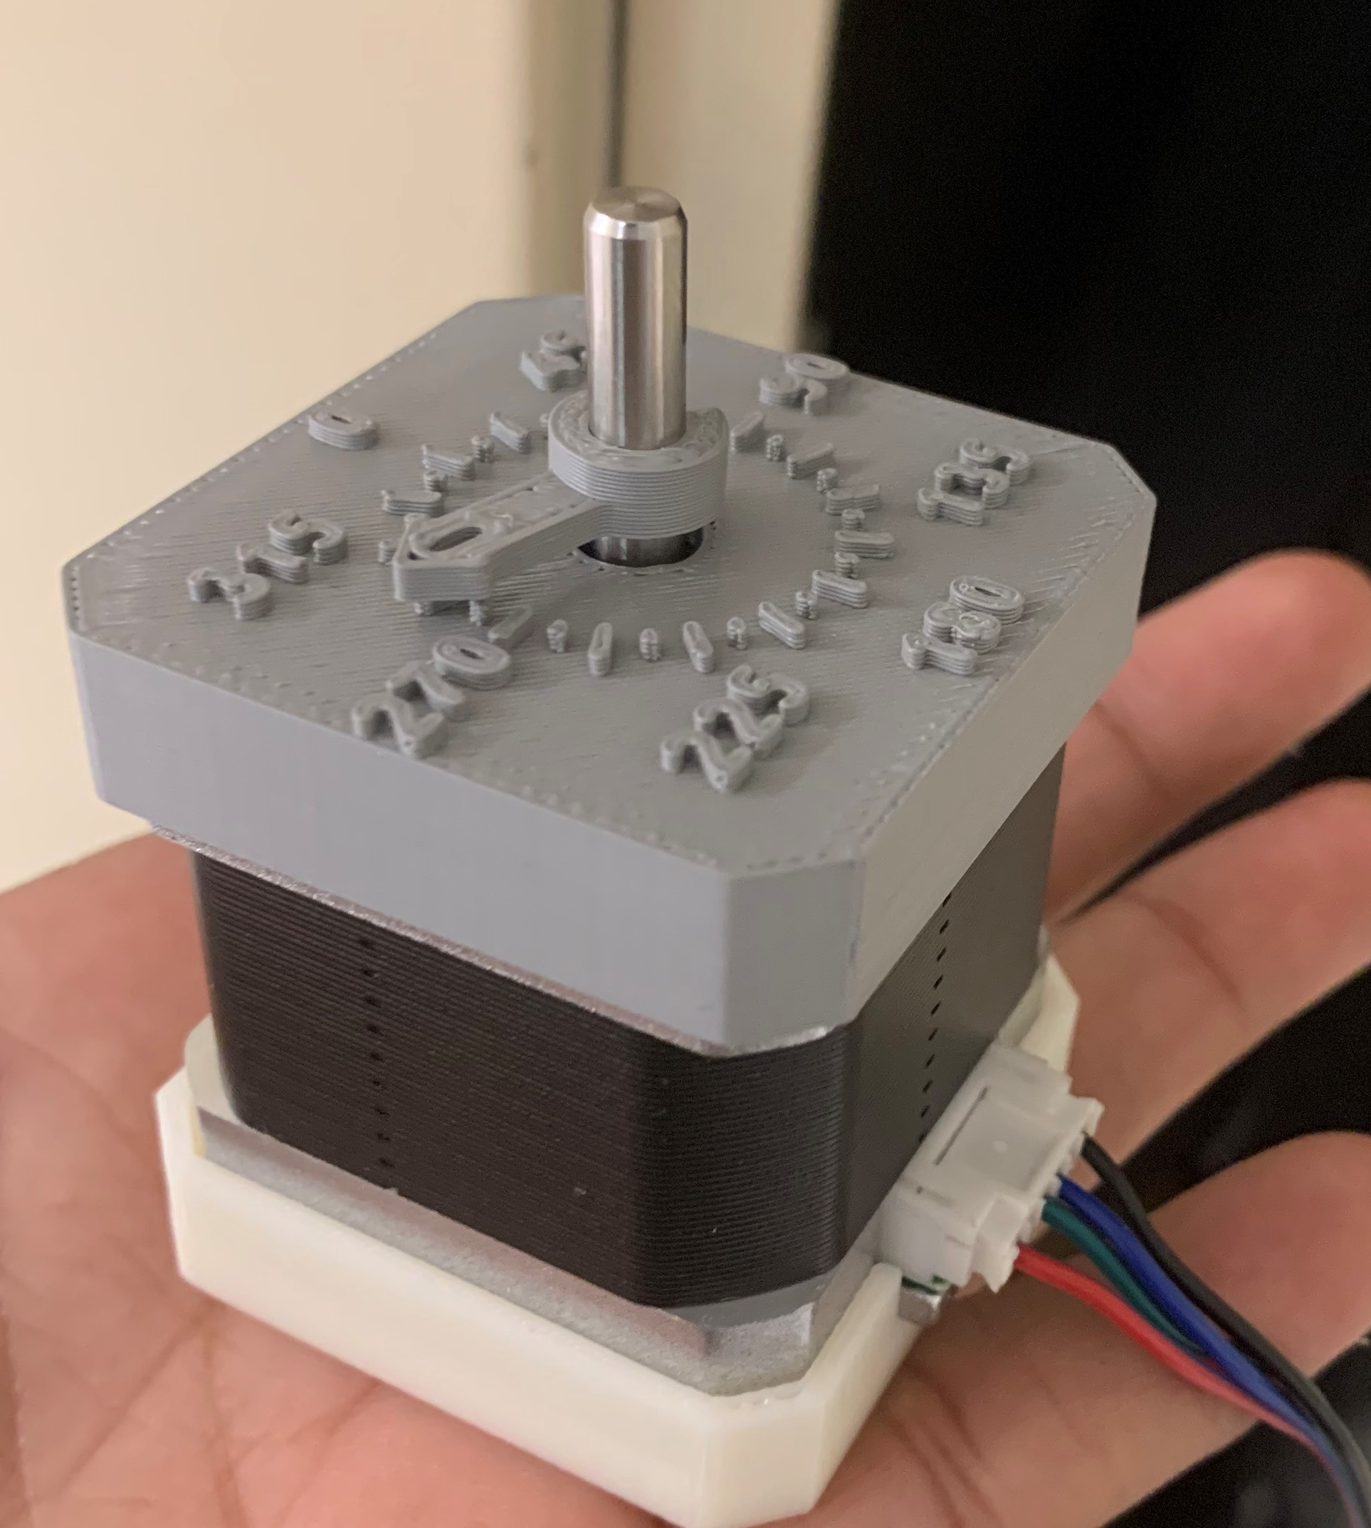
Enclosure

Slide 6
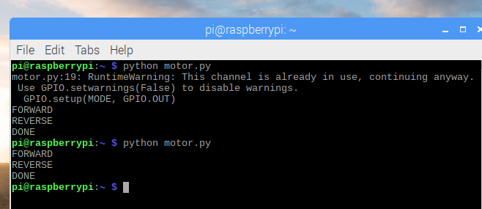
Motor movement output
The output of the code reading

Slide 7
Previous courses knoWledge
Technical c : LEARNT REAGARDING THE RASPBERRY PI
Unix scripting: commands in the terminal and writing the html code in index.md
Technical reading and writing skills : prepared the reports
Digital and interface systems : working with motor and power supplies
Electric devices and circuits : breadboard connections
Embedded systems: acquired more knowledge as programming with the raspberry pi

